Slide 1
Whites Creek High Data Dive
Please sit in a group. Thanks!
February 13, 2018
Margie Johnson, Ed.D.

Slide 2
Outcomes
The outcomes for the meeting are to model the collaborative inquiry process for analyzing data and to create Spring 2018 recommendations for supporting student success.

Slide 3
Visual Synectic
What is your VISION for students at Whites Creek High School?

Slide 4
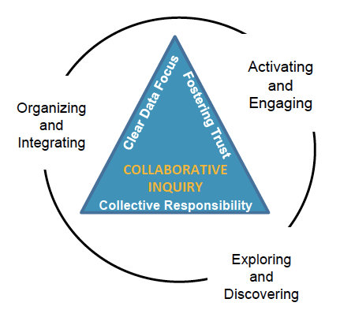
MNPS Collaborative Inquiry
Collaborative Inquiry is a data-based team process that consciously uses the collaborative learning cycle (activating and engaging, exploring and discovering, and organizing and integrating) and the qualities of effective groups (fostering a culture of trust, maintaining a clear focus, taking collective responsibility and data-informed decision-making).
MNPS Collaborative Inquiry Community of Practice

Slide 6
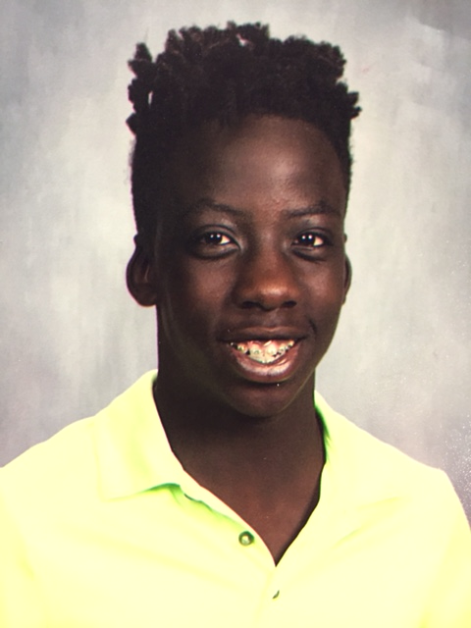
Calibrating Activity

Slide 7
Exploring and Discovering—Data Dive
Assessment—
Assessment Summary
MAP
ACT
EOC
Attendance
Attendance Dashboard (2 years)
Behavior
Behavior Dashboard (2 years)
http://datawarehouse.mnps.org

Slide 9
Given what was discussed today, what might be some next steps?
Stop
Continue
Start
Groups at Work – 2011 MiraVia LLC – All rights reserved

Slide 10
Next Steps

Slide 11
Reflection, Feedback, and Wrap-Up

Slide 12
Exit Ticket Reflection
What might be some actions you take as a result of our time together today?
Reflection

Slide 13
Feed FORWARD--- How Was Today’s Meeting
Individually
Use a post-it note to provide feedback.

Slide 14
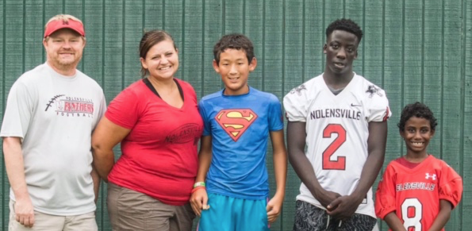
Wrap Up

Slide 15
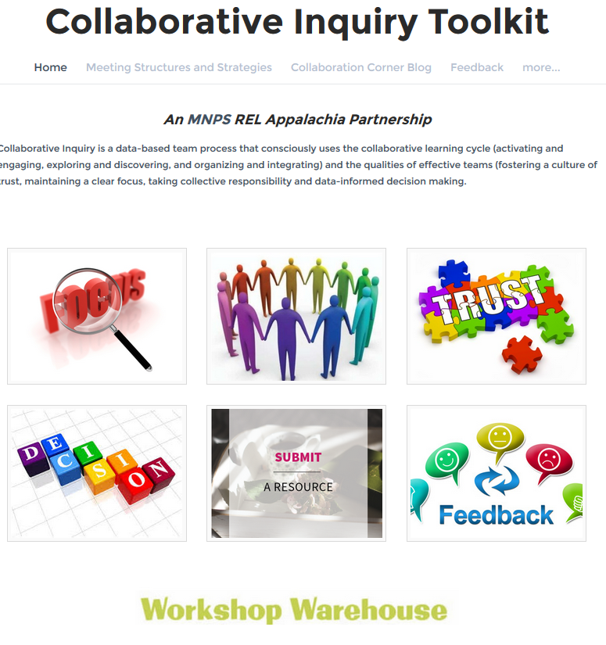
MNPS Collaborative Inquiry Toolkit
www.mnpscollaboration.org

