Slide 1
We Surveyed, So Now What? Using the Teacher Data Use Survey to Inform School Improvement
Jeffrey C. Wayman, Wayman Services, LLC
Margie Johnson, Metropolitan Nashville Public Schools
Stephanie B. Wilkerson, Magnolia Consulting, LLC

Slide 2
The TDUS and Metro Nashville Schools
In Fall 2016, IES and REL Appalachia released the Teacher Data Use Survey.
Metropolitan Nashville Public Schools administered the TDUS in five schools.
These schools are part of a Community of Practice focused on collaborative inquiry.
MNPS took actions in response to TDUS results.
Today, we’ll talk about how that’s going for them.
Notes:
- Teachers are arguably the most important users of data for educational improvement.
- Unfortunately, leaders’ understanding of teacher experience in using data is anecdotal.
- TDUS provides an opportunity to establish an evidence base from which to understand teacher data use.
- The purpose of TDUS is to help school and district leaders learn more about attitudes, perceptions, and practices regarding teacher data use.

Slide 3
The Two Parts of Today’s Talk
Introduce the Teacher Data Use Survey.
Describe Metro Nashville TDUS:
Specific results they drew out.
The actions they took.
Initial outcomes from those actions.
Notes:
- Teachers are arguably the most important users of data for educational improvement.
- Unfortunately, leaders’ understanding of teacher experience in using data is anecdotal.
- TDUS provides an opportunity to establish an evidence base from which to understand teacher data use.
- The purpose of TDUS is to help school and district leaders learn more about attitudes, perceptions, and practices regarding teacher data use.

Slide 4
The Teacher Data Use Survey

Slide 5
Why the TDUS Useful?
Teachers are the most important data users for educational improvement.
Leaders’ understanding of teacher data use is often anecdotal.
TDUS can help establish an evidence base for understanding teacher data use.
TDUS can help leaders learn more about attitudes, perceptions, and practices regarding teacher data use.
Notes:
- Teachers are arguably the most important users of data for educational improvement.
- Unfortunately, leaders’ understanding of teacher experience in using data is anecdotal.
- TDUS provides an opportunity to establish an evidence base from which to understand teacher data use.
- The purpose of TDUS is to help school and district leaders learn more about attitudes, perceptions, and practices regarding teacher data use.

Slide 6
The Teacher Data Use Survey
REL Appalachia convened a team of five experts in data use (Wayman, Cho, Mandinach, Supovitz, Wilkerson) to create the TDUS.
TDUS subjected to IES’ peer-review process.
Three versions triangulate perceptions of teacher data use.
Teacher, administrator, instructional support staff.
TDUS is based on a conceptual framework for teacher data use.

Slide 7
Conceptual Framework: How Teacher Data Use “Works”

Slide 8
TDUS Scales and Individual Items
Much of TDUS is made up of scales that measure various parts of conceptual framework.
For example, 3 scales measure organizational supports.
Support for data use
Principal leadership
Computer data systems
Some single items also measure conceptual framework.

Slide 9
Unique TDUS Feature: Specific Forms of Data
How teachers use data depends on what those data are, so TDUS asks about specific data.
First set of questions asks about access, frequency of use, and usefulness of specific forms of data.
Survey planners choose data in their school or district to ask about.
Second set of questions asks in detail how these data are used.
Survey planners choose up to 4 forms of data.

Slide 10
How Do I Get the TDUS?
TDUS work funded by REL Appalachia and IES.
IES has made the TDUS available for free.
TDUS and associated manual are available at this intuitively-worded URL: https://ies.ed.gov/ncee/edlabs/projects/project.asp?projectID=2461
Or you can just google it.
Notes:
- Teachers are arguably the most important users of data for educational improvement.
- Unfortunately, leaders’ understanding of teacher experience in using data is anecdotal.
- TDUS provides an opportunity to establish an evidence base from which to understand teacher data use.
- The purpose of TDUS is to help school and district leaders learn more about attitudes, perceptions, and practices regarding teacher data use.

Slide 11
TDUS Use in Metro Nashville Public Schools

Slide 12
MNPS and Collaborative Inquiry
MNPS Community of Practice
Spring 2016
5 Middle Schools
TDUS Administered to CoP Schools
70 teachers, 7 administrators, 12 instructional support staff
Data Informed Implementation
MNPS central office staff and school staff reviewed TDUS data to inform 2016-2017 implementation
http://bit.ly/mnpstdus
Notes:
http://www.mnpscollaboration.org/collaboration-corner-blog/central-office-support-for-collaborative-inquiry

Slide 13
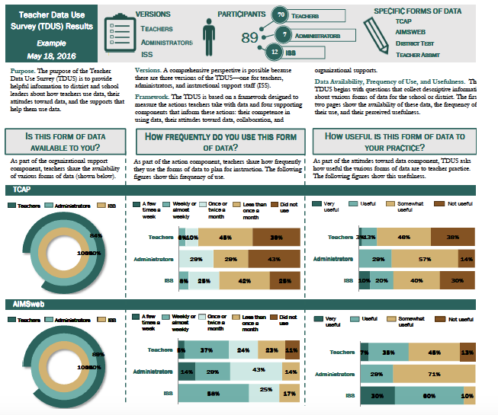
Observations
Teacher/Administrator Misalignment
Low Teacher Perception of Support
Low Teacher Rating of Collaborative Team Actions

Slide 14
Teacher/Administrator Misalignment
Administrators said teachers used data twice as much as teachers said they did.
Teachers reported AIMSweb data (RTI data) more useful to them than administrators did.
20% of teachers reported not having collaborative team meetings – 0% of admin.
Action: updated Innovation Configuration map to include definitions and common language.
Outcome: Starting to see better alignment. But still seeing compliance-based processes.
http://bit.ly/mnpsicmap
Notes:
Collecting Data again May 2017, which will be used for another meeting to discuss 2017-2018 implementation

Slide 15
Low Teacher Perception of Support
Teachers’ average rating of support for data use was 2.78 on a 4-point scale.
Action: increased professional learning supports.
Increased training for data coaches.
Collaborative inquiry toolkit.
Increased contact with business intelligence coordinator.
Outcome:
Workshop participants liked having a voice.
But change is slow…we think we’re seeing improvement, but it’s slow.

Slide 16
Low Teacher Rating on Collaborative Team Actions
Teachers’ average rating of collaborative team actions was 2.59 on a 4-point scale.
Action:
Tools and strategies for facilitating collaborative meetings.
Provided Leading Collaborative Inquiry Teams workshop, along with site visits to model practice and provide coaching.
Outcome: Not sure yet.
People are trying to implement these changes.
Survey will tell more about attitudes and actions.

Slide 17
Summary
Ironic that schools/districts have very little evidence on how teachers use data.
The TDUS provides information to this end.
TDUS is like any form of data. It provides info. It has limits.
Know the context. Apply professional judgment.
This work is never done. We are all about continuous improvement.
Used well, TDUS can help make life better for educators.

Slide 18
Let’s Keep the Conversation Going
Jeffrey C. Wayman, Ph.D.,
Wayman Services, LLC
jeff@waymandatause.com
www.waymandatause.com @WaymanDataUse
Margie Johnson, Ed.D.,
Metro Nashville Public Schools
margie.johnson@mnps.org
www.mnps.org @MargieLJohnson3
Stephanie Wilkerson, Ph.D.
Magnolia Consulting, LLC
stephanie@magnoliaconsulting.org
www.magnoliaconsulting.org

