Slide 1
Using Collaborative Inquiry to Empower Culture and Climate Change
Please sit in groups. Thanks.
December 12, 2017
Shelly Dunaway, Ed.D
Margie Johnson, Ed.D.

Slide 2
Today’s Purpose and Outcome
Our purpose is to foster a culture of collaboration to support student success.
Our outcome for today’s meeting is to use the collaborative inquiry process to analyze culture and climate data for informing culture and climate change.

Slide 3
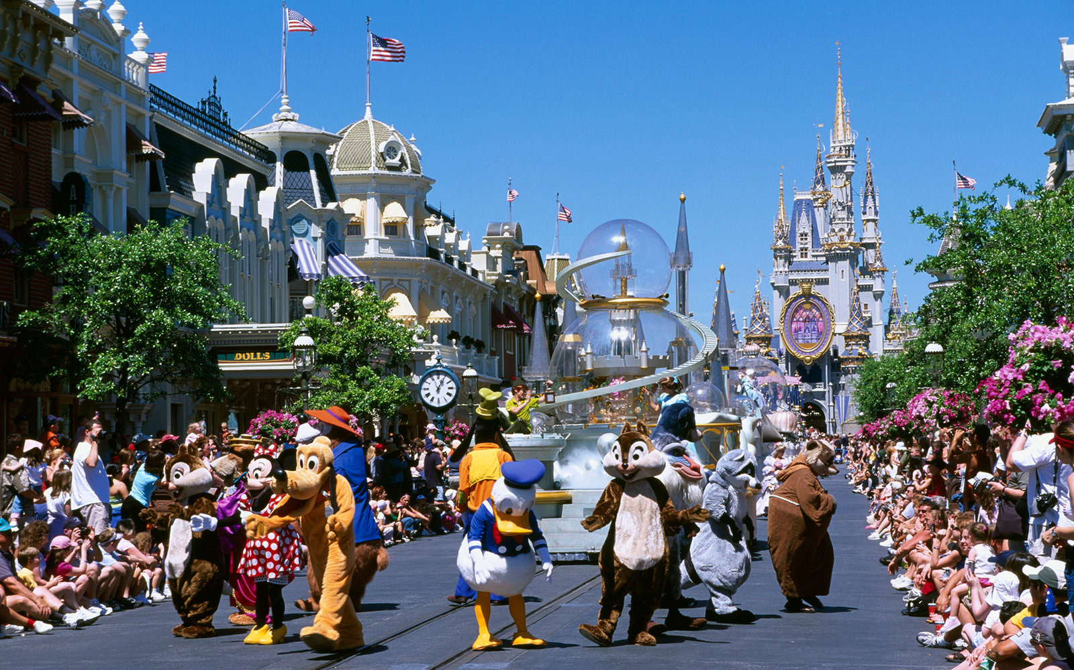
Culture is like…..
Because……..
Groups at Work – 2011 MiraVia LLC – All rights reserved

Slide 4
MNPS Collaborative Inquiry
Collaborative Inquiry is a data-based team process that consciously uses the collaborative learning cycle (activating and engaging, exploring and discovering, and organizing and integrating) and the qualities of effective groups (fostering a culture of trust, maintaining a clear focus, taking collective responsibility and data-informed decision-making).
MNPS Collaborative Inquiry Community of Practice

Slide 5
Collaborative Learning Cycle
Organizing and Integrating
What inferences, explanations, or conclusions might we draw?
What additional data sources might verify our explanations?
What solutions might we explore?
What data will we need to guide implementation?
Activating and Engaging
What assumptions do we bring?
What are some predictions we are making?
What questions are we asking?
What are some possibilities for learning?
Managing
Modeling
Mediating
Monitoring
Exploring and Discovering
What important points seem to pop out?
What patterns, categories, or trends are emerging?
What seems to be surprising or unexpected?
What are some ways we have not yet explored these data?
--Lipton, L. & Wellman, B. (2012). Got data? Now what? Bloomington, IN: Solution Tree, Inc.

Slide 6
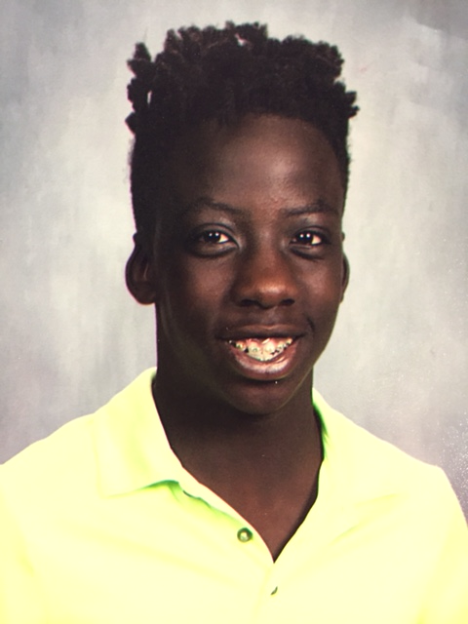
Calibrating Observations

Slide 7
Data Dive Observations
SEL Walkthrough Data
Student Panorama Data
Teacher Panorama Data

Slide 8
Given what was discussed today, what might be some next steps?
Stop
Continue
Start

Slide 9
Reflection
What might be some actions you take as a result of our time together today?

Slide 10
Feedback--- How Was Today’s Meeting
Individually
Use a post-it note to provide feedback.

Slide 11
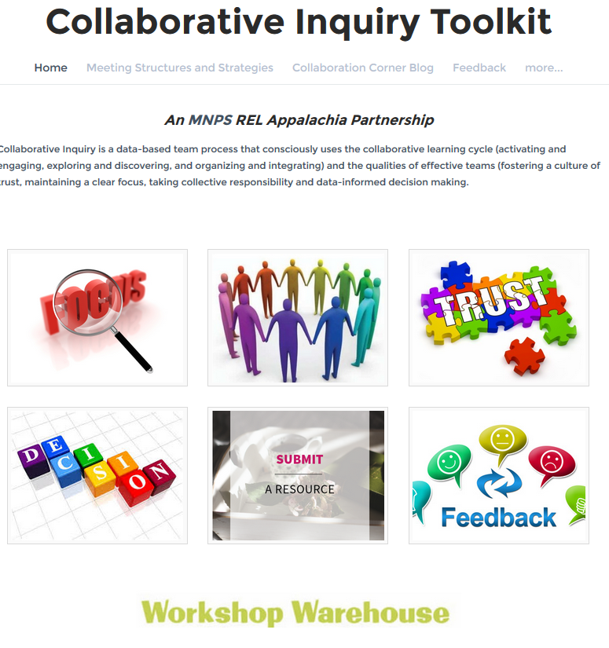
MNPS Collaborative Inquiry Toolkit
www.mnpscollaboration.org

Slide 12
References
Lipton, L. & Wellman, B. (2012). Got data? Now what? Bloomington, IN: Solution Tree.
Lipton, L. & Wellman, B. (2011). Groups at work: Strategies and structures for professional learning. Sherman, CT: MiraVia, LLC.

Slide 13
Thanks for all you do for our students!
Hope you have a wonderful day!

Slide 14
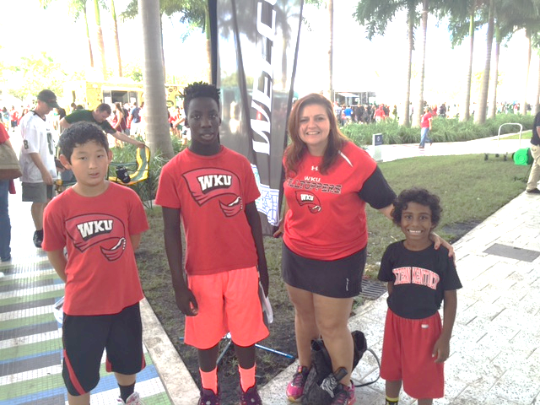
Wrap-Up….

