Slide 1
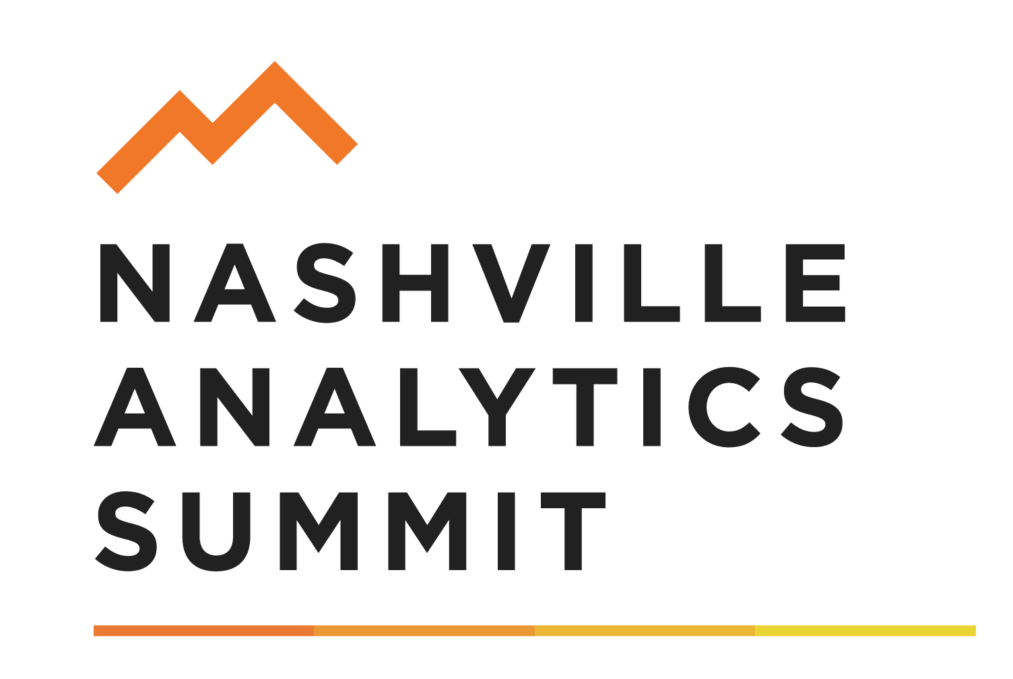

Fostering a Culture of
Data-Informed Decision Making
Dr. Margie Johnson
Business Intelligence Coordinator
Metropolitan Nashville Public Schools (MNPS)
August 11, 2016

Slide 2

Our purpose today is to learn about the MNPS data warehouse, its implementation and lessons learned, particularly the development of a Data-Informed Decision Making Ecosystem to build capacity of employees to use data for making informed decisions.

Slide 3
Looking Back - Looking Ahead
Individually, complete the chart:
1. | 2. | 3.
Think back to how people in an organization worked together when you were a child..
How do people within an organization work together today?
What is your vision for how people within an organization should work together?
Adapted from Groups at Work – 2011--MiraVia LLC

Slide 4
Looking Back - Looking Ahead
Task Groups:
Share and explore your responses
Consider the following:
  What strikes you as you share and compare?
  What are some patterns you are noticing?
  What are some implications for your work?
Adapted from Groups at Work – 2011--MiraVia LLC

Slide 5
Metropolitan Nashville Public Schools
42nd largest school district in the US
88,000 students; 6,000 teachers; 4,000 support staff
Students speak 100 + different languages
160 buildings
Notes:
As with many other industries, educational organizations collect a wealth of data. Prior to age of technology, how was most data collected? Via paper and pencil…. When spreadsheet software hit the scene, many organizations begin collecting data digitally in a spreadsheet. Of course, each group collected the data they needed at the time. As a result.........

Slide 6
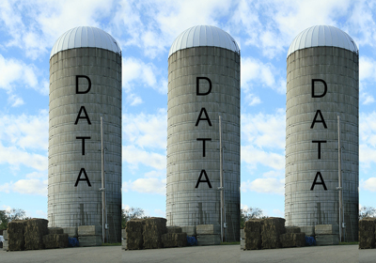
Data Silos
Notes:
Data silos began showing up all across the organization. As technology improved, questions became more sophisticated and the need to link the data silos occurred. In today’s age of information, one asset organizations have to leverage is their data. Understanding the importance of linking data and getting access to users, MNPS set out on a journey in 2009 to bring down the data silos throughout the organization and develop a data warehouse.

Slide 7
Education as a Data-Driven Enterprise
Student Management
Payroll
Expenditures
Education & Degree
Assessments
Financial
Licensure & Certifications
Exceptional Education
Business
Intelligence
Student
Staff
Observations & Evaluations
Programs & Services
Attendance
Student Health
Operations
Professional Development
Post Secondary Performance
Instructional Technology
Transportation
Food Service
Notes:
After almost one year of development, the MNPS Data Warehouse went live to users throughout the district in 2010-2011. Today, our data warehouse has over 100 different reports with up to 7 years of data and houses over approx. 350 million records of data.
Having a data warehouse, ie big data system is great. However, the technological part is probably the easiest part when you look at the parts of big data. Let’s look at the components of big data, which is a topic not only popular in education but in other industries , such as healthcare, as really the competitive edge in today’s information age is data. Data is an asset for organizations and organizations that can use it well are rising to the top in their respective fields.

Slide 8
Data Systems
Processes
Data System
People
Notes:
Metro Nashville Public Schools developed brought the world of big data to our district by developing the data warehouse. When you look at big data, there are three components….

Slide 9

Driving Question
How can we unleash the power of data to ensure the educational success of all students?

Slide 10

Data have no meaning. Meaning is imposed through interpretation
(Wellman & Lipton, 2004, pp. ix-xi).
Notes:
Since data has no meaning, I propose to you that the key to answering the driving question of unleashing the power of data for ensuring student success or whatever your goal may be is through the data conversations. Let me demonstrate what I mean. You have heard of Charles Dickens and The Tale of Two Cities, right?…. Let’s take time for me to tell you about the Tale of Two Data Meetings, then we will dive into the Data Informed Decision Making Ecosystem I’ve developed.

Slide 11
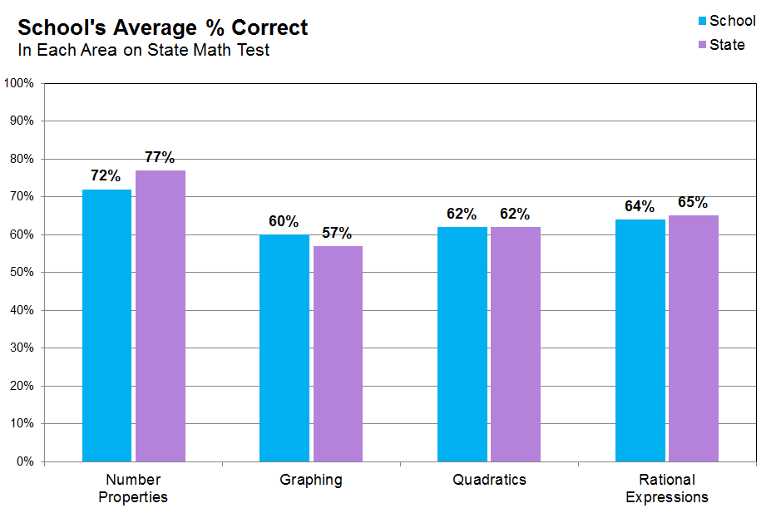
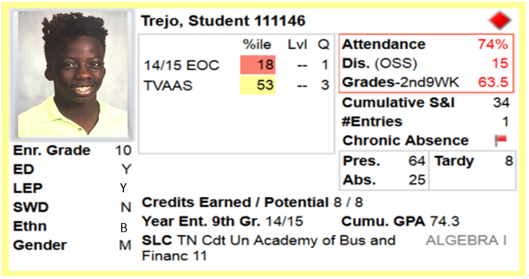
The Tale of Two Data Meetings
Notes:
Now for this part, you will need to be actively involved. Are you ready? Let’s start with the first data meeting using the data that Dr. Rankin shared with us.

Slide 12
Notes:
As she shared, this graph is often misinterpreted by educators. In this data meeting, I am the leader of the meeting. I display the data for everyone and proceed to interpret the data and tell you that as a team we are going to work on graphing this year as it’s our weakest area of performance and students need to improve in this area. We proceed to develop an action plan around graphing and spend the remainder of the year focused on this area….
Now, let’s shift to another data conversation.
To ground ourselves in what takes place at schools and districts, let’s view a sampling of data as it’s typically reported to educators.
The scores being graphed are from a state math test that was used in California leading up to Common Core.
Now, let’s supposed you’ve been given this data and asked to use it, as one of multiple measures, to inform your decisions at a school or district.
I’m going to ask you 2 questions, and I’d like you to come up with the answer in your head [or on sheet if we have handouts].
Q: In which tested area [Pointing to bottom x-axis labels] did the school perform best?
[Give wait time, repeat question]
Got your answer? OK, last question:
Q: In which tested area did the school perform worst?
[Give wait time, repeat question]

Slide 13

Observations
Notes:
Now, let’s start by looking at this picture and making observations about it.
First, let’s take 30 seconds to individually complete the task.
Now, each person needs to share in the small group.
What questions do we have about these student?

Slide 14
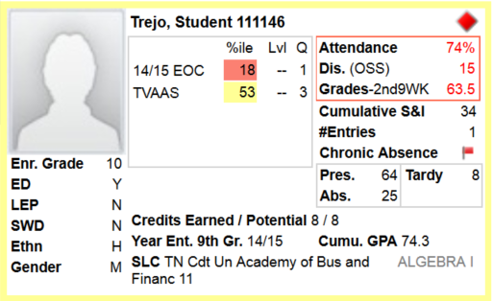

MNPS Virtual Data Wall Card
Y
B
Notes:
This report is called our data wall card. If any of you are familiar with Dr. Michael Fullan, he & Dr. Lyn Sharratt wrote a book entitled, Putting FACES on Data.
Now, I now that some of these data points may be foreign to you, especially since in US education we like to use lots of acronyms, but feel free to ask me questions as you are making observations again.
What important points seem to pop out?
What patterns, categories, or trends are emerging?
What seems to be surprising or unexpected?
What are some questions this data generates?

Slide 15
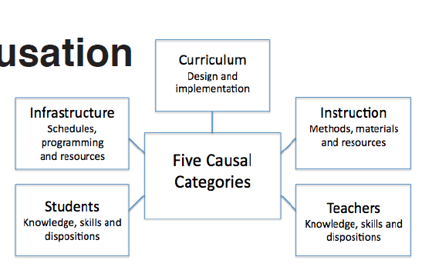
Theories of Causation
--Wellman & Lipton, 2012
Notes:
Now that we have activated, engaged, explored, and discovered observations about the data, the next part of our conversation is to begin organizing and integrating the data to generate theory. During this phase, we move from problem finding to problem solving. When looking at causation in education, theories fall into these five causal categories---- For time sake, we are not going to generate a theory to test with our example, but let’s compare and contrast our data meetings using a Venn Diagram.
If we were all educators, I’d provide you with a worksheet for us to develop theories and then begin gathering more data for testing our theories. Since that’s not the case, let’s share at least one theory that someone has and the data we would need to collect to answer the theory, then we will end the conversation here.

Slide 16
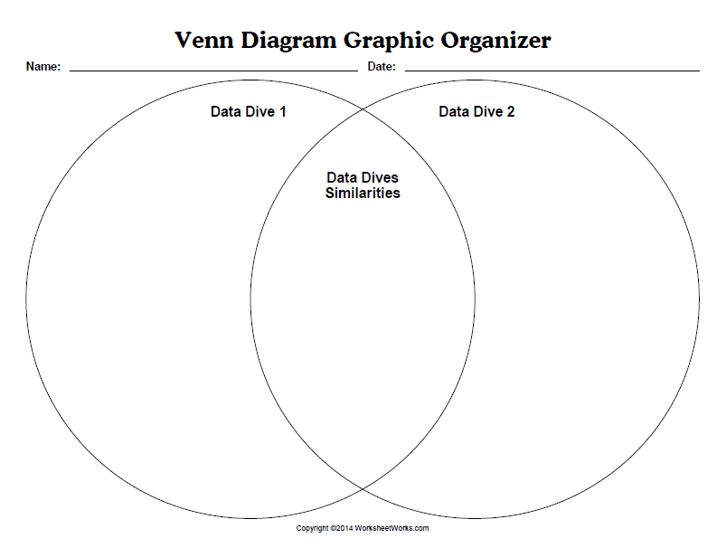


Comparison of Data Meetings
Notes:
You just went through 2 Data Dives. Think through each conversation and compare and contrast them…..
Share with pair partner. Each pair choose one thing to share with whole group in 4 minutes.
Let’s wrap up these data simulations and discuss a term that appears in research the describes the differences between the two data conversations.

Slide 17
Notes:
So Number Properties is actually where the school performed worst, because here the school is farthest behind the state.
…and Graphing is actually where the school performed best, because here the school performed better the state.
Of course, not all assessments work like this, but education data is commonly tricky to understand.
For example, only 11% of educators (very smart people) answered these 2 questions correctly, and those people used this particular test’s data regularly, so don’t feel bad if you got the questions wrong.
This reality just calls attention to why particular strategies are needed to empower users when making data-informed decisions.

Slide 18
How do we bridge the gap between data and results, so all students have educational success?
What is the bridge made of?
Collaborative Inquiry
Data
Results
Love, 2009
Notes:
Remember our research question about using data to ensure the educational success for all students? When you look at data use research, the bridge for the gap between data and results is collaborative inquiry. Well, what is collaborative inquiry?
Collaborative inquiry establishes a culture of data-informed decision making.
Dana, N. F., Thomas, C., & Boynton, S. (2011). Inquiry: A districtwide approach to staff and student learning. Thousand Oaks, CA: Corwin Press.
Datnow, A., Park, V., & Wohlstetter, P. (2007). Achieving with data: How high-performing school systems use data to improve instruction for elementary students. Los Angeles: CA: Center on Educational Governance Rossier School of Education at the University of Southern California.
Hamilton, L., Halverson, R., Jackson, S., Mandinach, E., Supovitz, J., & Wayman, J. (2009). IES practice guide: Using student achievement data to support instructional decision making. Washington DC: U.S. Department of Education.
Lipton, L. & Wellman, B. (2012). Got data? Now what? Bloomington, IN: Solution Tree Press.
Love, N. (2009). Using data to improve learning for all: A collaborative inquiry approach. Thousand Oaks, CA: Corwin Press.
Knapp, M., Swinnerton, J., Copland, M., & Monpas-Huber, J. (2006). Improving leadership for learning: Data-informed leadership. Seattle, WA: Center for the Study of Teaching and Policy at the University of Washington.
Mandinach, E. B. & Jackson, S. (2012). Transforming teaching and learning through data-driven decision making. Thousand Oaks, CA: Corwin Press.
Marsh, J., McCombs, J., & Martorell, F. (2010). How instructional coaches support data-driven decision making: Policy implementation and effects in Florida middle schools. Educational Policy, 24(6), 872-907. Doi:10.1177/0895904809341467.
Parker, K., City, E., & Murnane, R. (2005). Datawise: A step-by-step guide to using assessment results to improve teaching and learning. Cambridge, MA: Harvard Education Publishing.
Wayman, J., Cho, V., Jimerson, J., & Spikes, D. (2012). District-wide effects on data use in the classroom. Education Policy Analysis Archives, 20(25), 1-31.
Wayman, J., Jimerson, J., & Cho, V. (2012). Organizational considerations in establishing the data-informed district. School Effectiveness and School Improvement: An International Journal of Research, Policy, and Practice, 23(2), 159-178. Doi:10.1080/09243453.2011.652124.
Wellman, B., & Lipton, L. (2004). Data-driven dialogue: A facilitator’s guide to collaborative inquiry. Sherman, CT: MiraVia, LLC.
White, S. (2005). Show me the proof! Tools and Strategies to Make Data Work for You. Beyond the Numbers: Making Data Work for Teachers & School Leaders. Englewood, CO: Lead + Learn Press.

Slide 19

Collaborative Inquiry
Collaborative Inquiry is stakeholders working together to uncover and understand problems and to test out solutions together through rigorous use of data and reflective dialogue.
Assumption: This process unleashes the resourcefulness of stakeholders to continuously improve learning.
Adapted from N. Love, K.E. Stiles, S. Mundy, and K.DiRanna, 2008
Notes:
During the second data dive, we used a collaborative inquiry approach. Instead of me telling you what to do, I facilitated a collaborative conversation to get the various perspectives in the room before generating a theory and taking action.
Also, this entire lecture today is an example of collaborative inquiry…..Remember how we opened up with the synectics activity. These two strategies go hand in hand when it comes to solving complex problems being faced by our world today.
Of course, several theories of collaborative inquiry exist because of time, we are not going to look at the different theories, but I did include them at the end of the presentation that is posted in the dropbox for you to access.
Now that we have a foundation about data conversations, let’s talk about the data informed decision making ecosystem I developed to guide my work within the school district.

Slide 20
Data-Informed Decision Making Ecosystem
Culture of Collaborative Inquiry
Common Language
Data Literacy & Analysis
Data Access
--Johnson, 2016
Notes:
After consolidating research from multiple sources and conducting a needs assessment where I used multple sources of data, including teacher interviews. Here is the ecosystem model I developed for data-informed decision making that guides my work.
I have to share that I originally called it a framework, but that word never seemed to fit as a framework makes me think of hierarchy of steps that must be followed in order to ensure the goal is reached. Thinking back to my background as a secondary science teacher and after presenting at a business conference about building capacity for using data, I began thinking about ecosystems and how they have many parts that work together. There’s not one specific entry point, but the parts need to work together to balance the system.
Of course, you will notice that the center part of the ecosystem is grounded in the research about data use because the heart of making sure data is understood is a culture of collaborative inquiry and the other circles work together to support that culture. Let’s take a deeper dive into the each component of the ecosystem.

Slide 21
Culture of Collaborative Inquiry
Notes:
Therefore, you will see that the heart of the ecosystem is creating a culture of collaborative inquiry.

Slide 22
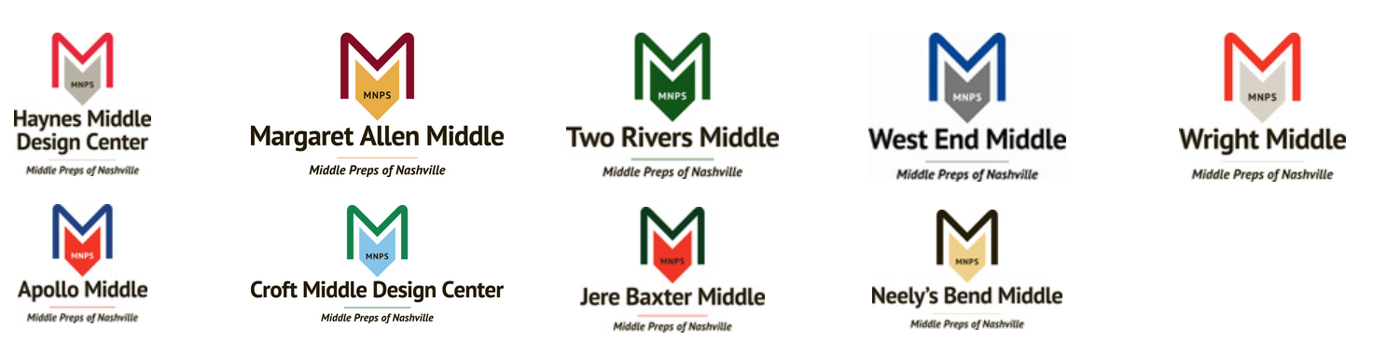
MNPS Collaborative Inquiry
Collaborative Inquiry is a data-based team process that consciously uses the collaborative learning cycle (activating and engaging, exploring and discovering, and organizing and integrating) and the qualities of effective groups (fostering a culture of trust, maintaining a clear focus, taking collective responsibility and data-informed decision-making).
MNPS Collaborative Inquiry Community of Practice

Slide 23
Collaborative Learning Cycle
Organizing and Integrating
What inferences, explanations, or conclusions might we draw?
What additional data sources might verify our explanations?
What solutions might we explore?
What data will we need to guide implementation?
Activating and Engaging
What assumptions do we bring?
What are some predictions we are making?
What questions are we asking?
What are some possibilities for learning?
Managing
Modeling
Mediating
Monitoring
Exploring and Discovering
What important points seem to pop out?
What patterns, categories, or trends are emerging?
What seems to be surprising or unexpected?
What are some ways we have not yet explored these data?
--Lipton, L. & Wellman, B, 2012

Slide 24
Data Access
Notes:
I’ve already talked about the development of the MNPS data warehouse. Basically, we have applied the concept of big data in our educational organization. When you think big data systems, many time people only think of the technology component. However, I’d challenge you to think of a big data system as having three different parts.

Slide 25
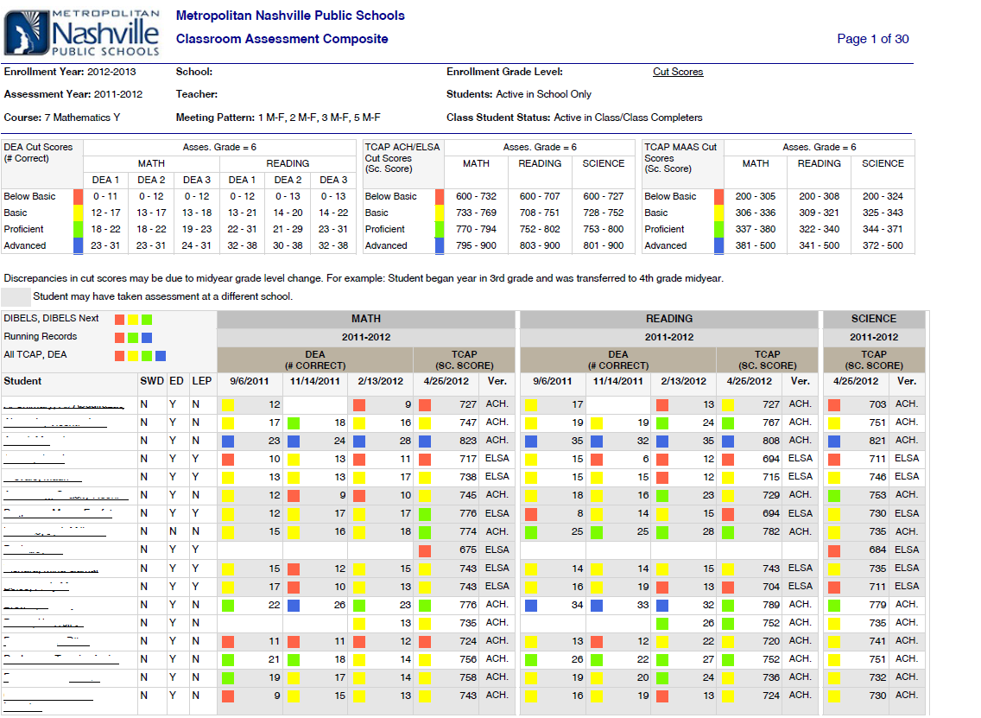
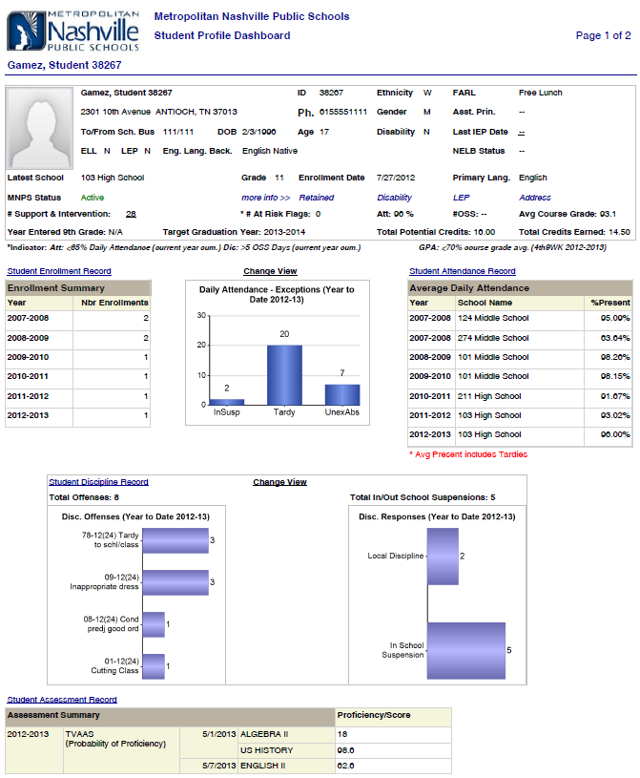

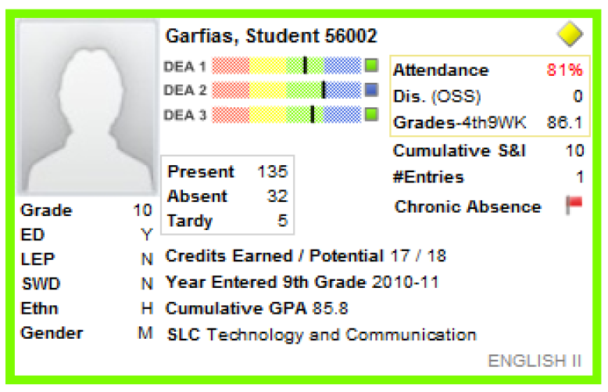
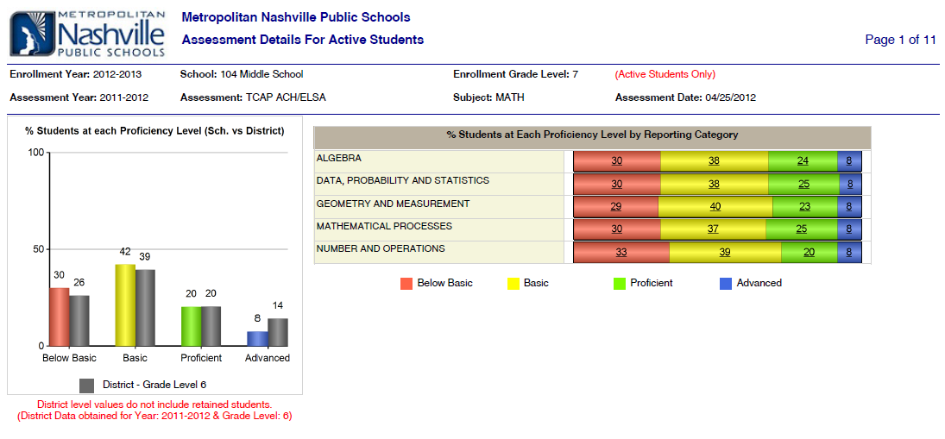
Data Warehouse
Notes:
The area where the ecosystem was strong was Data Access. We had a data warehouse where users could now access the area. Another area of support we did have was

Slide 26
Data Literacy & Analysis
Notes:
Just because there’s access to lots of data, doesn’t mean people will use it. The district did employ 12 data coaches, whose role was to provide data literacy and analysis support to schools. Of course, 12 data coaches with 160 schools meant that each one had approximately 13 schools each. Therefore, we needed to look for alternative ways for supporting data literacy and analysis. It was during this search that I virtually met Dr. Rankin, who shared with me her OTC Data Standards that we then began putting into place within my school district to add another layer of data literacy and analysis support for educators. The next slide shows you some examples of the data guides and monthly data spotlight newsletter that I’ve been doing to support educators.

Slide 27
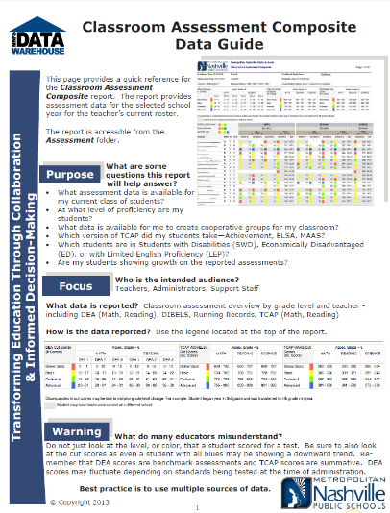
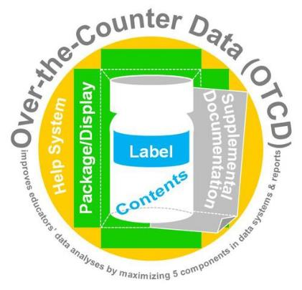
Data Literacy & Analysis
Rankin, J., 2016
Notes:
Also following Dr. Rankin’s data standards, we make sure our reports follow good visualization guidelines, have labels, and link the data guides within the data warehouse for additional support.

Slide 28
Common Language
Notes:
Where the bulk of my work has been in trying to balance the Data Informed Decision Making Ecosystem has been the common language. In the US, we like to develop catchy terms for latest initiatives occurring in education. Do you have any of them here in the UK?
We have several in the US and collaborative inquiry was another term that sounded great, but what did it really mean. Therefore, we formed a collaborative partnership with the Appalachia Regional Educational Laboratory to help us develop a common language for collaborative inquiry.

Slide 29


Developing a Common Language
Three practices for groups:
Root cause analysis to understand the problem.
Logic model development to define intended outcomes.
Innovation configuration maps to describe effective practices.

Slide 30
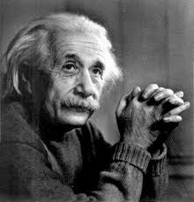
“You cannot solve a problem
from the same consciousness
that created it.”
—Albert Einstein
Notes:
“You cannot solve a problem from the same consciousness that created it.” So what Albert Einstein is getting at here is looking at the problem differently, from different angles and perspectives. Sometimes this requires a paradigm shift in our thinking, or second-order change. The next slide shows a visual of why understanding the problem is important.

Slide 31
Why is understanding the problem important?
Interventions
...and fix the...
Programs
Cause
Outcome
...that gives rise to a need for...
Products
...that will result in...
Problem
Cause
Create
Outcome
Services
Cause
Outcome
Policies
...that should affect the...
Notes:
So we begin with the problem. When we actually come together to talk about the problem, we learn that we don’t all define it in the same way. We might think we’re talking about the same thing, but in fact, when we look deeply, like through the root cause analysis, we discover there are several causes that create the problem.
When we understand the problem, we can see that it gives rise to a need for well-aligned interventions, such as programs, products, services and policies.
These, if implemented with fidelity, should result in our intended outcomes.
The outcomes should then…affect the original causes and ultimately fix the problem.
Many times we start at a shallow understanding of the problem, layer in the next best intervention and expect to see our intended outcomes. So, that is why understanding barriers that cause the problem informs an effective, well-aligned response to the need.

Slide 32
Root Cause Analysis
Notes:
REL Appalachia facilitated a one day workshop where teachers, data coaches, instructional specialists, school administrators and central office staff engaged in dialogue about barriers to effective data use. This fishbone shows the 11 biggest barriers the group identified. Those are in black type. You can see that these barriers are categorized on the “bones” of the fish and include data collection, data use preparedness, collaborative inquiry in data use, data analysis and interpretation, data system infrastructure and organizational data structures.
How the collaborative inquiry category differs from the other fishbone categories is that collaborative inquiry really focuses on how we engage in data use and the culture of inquiry around data use. So related to this area, barriers included having a common language, structures, protocols and processes in place that guide how educators engage in collaborative inquiry. A big barrier for Metro Nashville, and I suspect many districts, is lack of trust when groups come together to discuss data and engage in the inquiry process. This gets at creating an environment that feels psychologically safe to not always know the answers or solutions, and to explore data openly and objectively. Also, lack of leadership direction and organizational supports and follow through was identified as a barrier as well as having people with different perspectives and areas of expertise involved in collaborative inquiry, especially during the sense making process.
Using a root cause analysis, we develop a common language and shared understanding of the:
Problem.
Its causes.
Potential solutions.
Resource and professional learning needs to address the problem.

Slide 33
Logic Models
Notes:
So, with our root cause analysis, we asked the question, “What are the barriers to using a collaborative inquiry approach for effective data use?”
We then asked ourselves, “What outcomes would we expect to see if we implemented a collaborative inquiry approach to data use without any barriers?” To answer this question, we developed 4 logic models—one for each root cause referenced in the last slide—that identify short, intermediate and long-term outcomes for implementing collaborative inquiry.
So, logic models helped us develop a common language and shared understanding of:
Activities put in place to address root causes of the identified problem.
Results of those activities:
Short, intermediate, and long-term outcomes.
Ameliorates the problem.
Assumptions we make about cause-and-effect relationships (i.e., if we do X, then Y will result).
What we will measure to determine whether we are successful.
The logic models gives us a common language for where we want to go, but how will we get there? What are the practices that will help us achieve our outcomes, and do we have a common language and understanding about what those practices are? To answer these questions, we then began development of an innovation configuration (IC) map.

Slide 34
The Essence of an Innovation Configuration Map
“For teachers and others who are expected to implement new practices, all too frequently a problem is lack of clarity about what they are being asked to do.” (Hall & Hord, 2015, p. 53)
Notes:
Hall and Hord were studying the process for the other two aspects (Stages of Concern and Levels of Use) and found that before they examined how people interacted with and used a program, they really needed to define what the program was – as I keep saying, defining what IT IS.

Slide 35
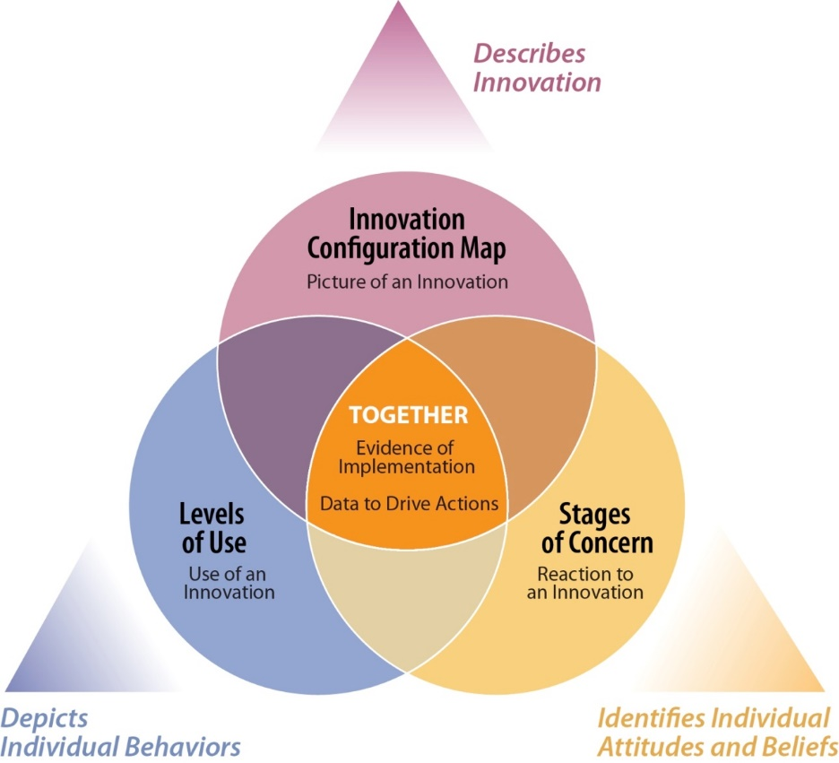
Innovation Configuration Map
https://vimeo.com/177430339
What is an IC Map?
How is an IC Map used?
--Hall & Hord, 2015
Notes:
In it’s simplest form, the key word in Innovation Configuration Map is MAP. A word map. It tells you how to get to your destination of ideal implementation showing various options along the way.
For Metro Nashville, we used an IC Map does to articulate the collaborative inquiry practices that data teams needs to implement to achieve the outcomes we defined in our logic model. The IC Map is a way of everyone being on the same page, so we all know an ideal practice when we see it.
An IC Map divides an innovation into its components and describes variations in practices from less than ideal,
A lot of people see similarities between IC Maps and rubrics, but they are different. IC Maps:
Share with implementers.
Engage users in development.
Support awareness of behaviors.
Are ordered but not necessarily ranked.
Evaluate program implementation.
Evaluation leads to action.
So, an IC Map helped us develop a common language and shared understanding by:
Defining what practices need to occur for outcomes to be realized.
Providing a continuum of concrete practices—a blueprint.
Agreement on what “ideal” looks like in practice.
Agreement on what is acceptable and unacceptable (“fidelity line”).

Slide 36
MNPS IC Map for Collaborative Inquiry

Slide 37
How an IC Map Cultivates a Common Language
  Provides a shared language about practices that should occur for outcomes to be realized.
  Provides a clear continuum of concrete practices—a road map.
  Reflects shared agreement on what “ideal” implementation looks like in practice.
  Documents what an initiative looks like, so everyone is on the same page, regardless of experience or position.

Slide 38
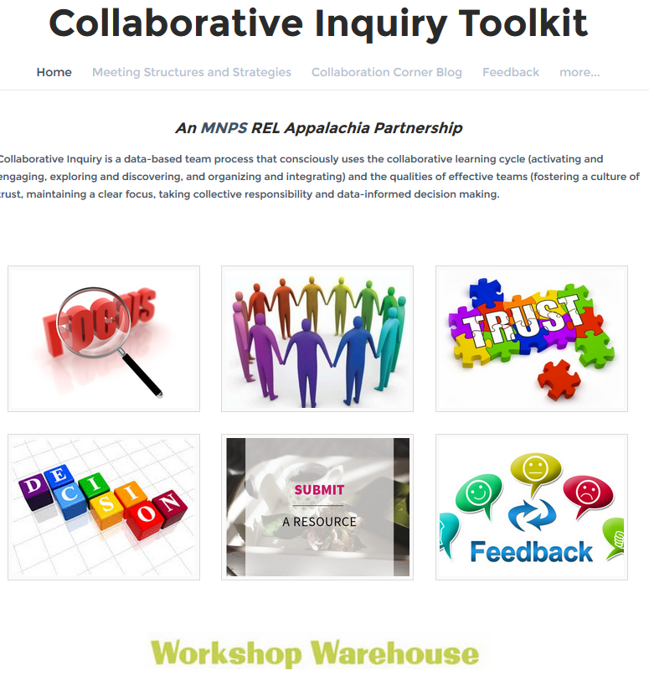


MNPS Collaborative Inquiry Toolkit
www.mnpscollaboration.org

Slide 39
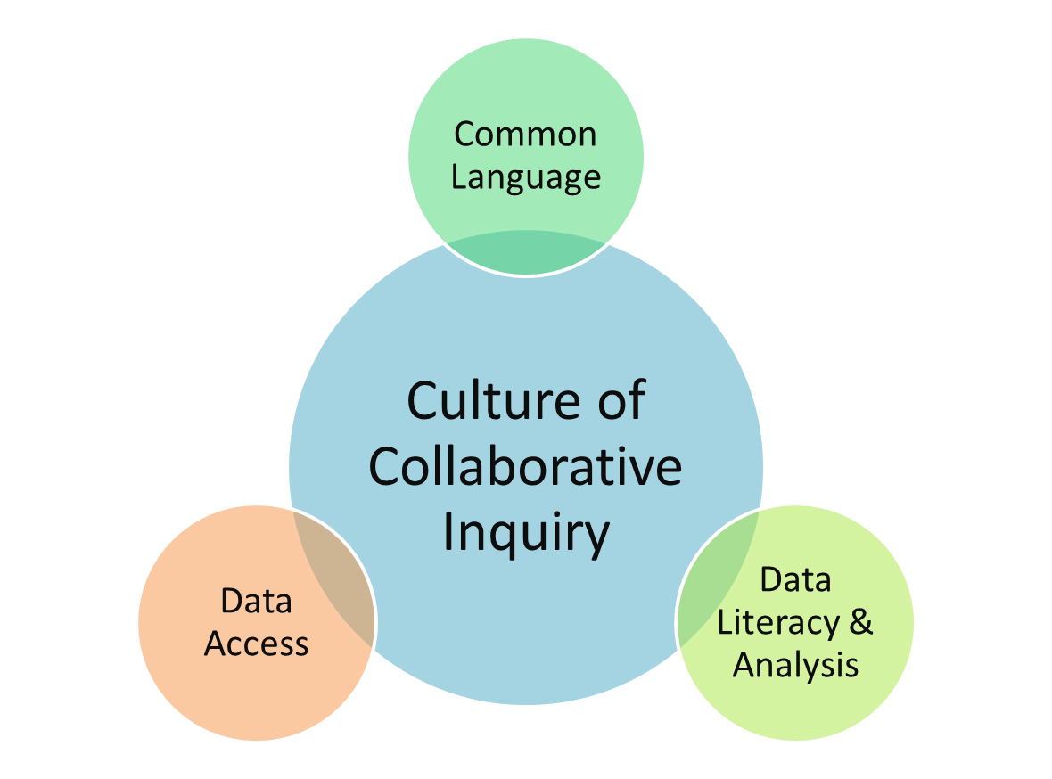
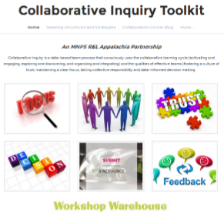
Summary of Best Practices
  Conduct a needs assessment.
  Use data to inform the creation of a vision for implementation.
  Engage multiple voices and perspectives to:
    Understand root causes of the problem;
    Collectively agree upon intended outcomes; and
    Identify a “road map” of data use practices and behaviors.
  Start small, then scale.
Notes:
Considerations (or are these also practices – at least the first two)
Identify and break down data use silos. (might need to speak to how we know when data use occurs in silos and why that’s a bad thing).
Approach data use as an ecosystem with multiple facets including data access, data literacy and knowledge, and common language
Data access without data literacy renders data meaningless. Build capacity to make sense of data and use it to inform decisions.
Data literacy without collaboration and a common language might solve individual student-focused problems, but it won’t address the bigger systemic issues causing those problems. Engage stakeholders in developing a common language for any change initiative.
Practices for Developing a Common Language for Data Use
Engage multiple voices and perspectives to
Develop a shared understanding of the root causes of the problem at hand. Don’t assume everyone has the same theory of causation.
Collectively define an agreed upon set of intended outcomes that would be achieved if the root causes of the problem were ameliorated.
Identify and create a “road map” of data use practices and behaviors that when implemented will lead result in the intended outcomes.

Slide 40

Reflection…3, 2, 1
3 Things you Learned
2 Things you Plan to Share
1 Thing you Plan to Do

Slide 41



Wrap Up
Notes:
The pictures you saw earlier are of my sons….. Here’s my family. They attend MNPS schools and as a parent, I implore us all to work together and improve the culture of all of our schools so can be the place where children WANT to go to school.

Slide 42
References
Hall, G. E., & Hord, S. M. (2015). Implementing change: Patterns, principles and potholes (4th ed.). Upper Saddle River, NJ: Pearson.
Johnson, M. (2016). Experience from the field. Excerpt obtained from How to Make Data Work: A Guide for Educational Leaders, pp. 171.
Lipton, L. & Wellman, B. (2012). Got data? Now What?: Creating and leading cultures of inquiry. Bloomington, IN: Solution Tree Press.
Love, N. (2009). Using data to improve the learning for all: A collaborative inquiry approach. Thousand Oaks, CA: Corwin.
Love, N., Stiles, K.E., Mundy, S., and DiRanna, K. (2008). The data coach’s guide to improving learning for all students: Unleashing the power of collaborative inquiry. Thousand Oaks, CA: Corwin.
Wellman, B. & Lipton, L. (2004). Data-driven dialogue: A facilitator’s guide to collaborative inquiry. Sherman, CT: MiraVia.

Slide 43
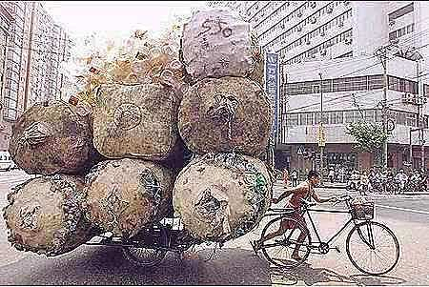

Conversation Starter

