Slide 1
JE Moss Elementary
Leadership Meeting
Margie L. Johnson, Ed.D.
July 25, 2016

Slide 2
Purpose
Our purpose today is to finalize the development of JE Moss’ values, vision, and mission statements. We will also develop rough draft SIP goals for culture, literacy, and numeracy.

Slide 3
Reflecting on the last meeting….
Our last time together was like…….
Because……

Slide 4
MNPS Collaborative Inquiry
Collaborative Inquiry is a data-based team process that consciously uses the collaborative learning cycle (activating and engaging, exploring and discovering, and organizing and integrating) and the qualities of effective groups (fostering a culture of trust, maintaining a clear focus, taking collective responsibility and data-informed decision-making).
MNPS Collaborative Inquiry Community of Practice

Slide 5
Collaborative Learning Cycle
Organizing and Integrating
What inferences, explanations, or conclusions might we draw?
What additional data sources might verify our explanations?
What solutions might we explore?
What data will we need to guide implementation?
Activating and Engaging
What assumptions do we bring?
What are some predictions we are making?
What questions are we asking?
What are some possibilities for learning?
Managing
Modeling
Mediating
Monitoring
Exploring and Discovering
What important points seem to pop out?
What patterns, categories, or trends are emerging?
What seems to be surprising or unexpected?
What are some ways we have not yet explored these data?
--Lipton, L. & Wellman, B. (2012). Got data? Now what? Bloomington, IN: Solution Tree, Inc.

Slide 6
Exploring and Discovering
Data Warehouse:
Assessment → Aimsweb-TLA Composite (Math and Reading)
Assessment → TCAP Three Year Comparison
Other??

Slide 7
Guiding Questions
What important points seem to pop out?
What patterns, categories, or trends are emerging?
What seems to be surprising or unexpected?
What are some questions this data generates?
Because
Notes:
While looking at this data just make observations that answer the following questions, I challenge us to AVOID using the word BECAUSE….. Research indicates that once we start explaining why, then we often stop exploring and lock into biased descriptions.
So the observations you made about this behavior data has been focused on outputs. When you look at a system, such as Haynes Middle, we also need to look at the inputs or Causal Theories…. Before we move into the Organizing and Integrating part of the cycle, let’s review the 5 Causal Theories.

Slide 8
Break

Slide 9
Change of Scenery--Antonyms
Each person has a word card.
On the signal, please find your antonym.
Sit with another antonym pair, so that each table is a quad.
Connell, 2013

Slide 10
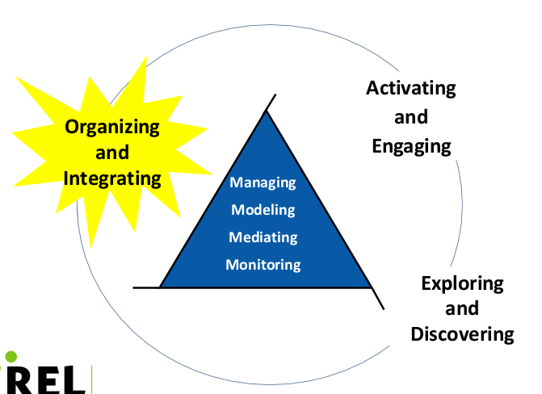
Organizing and Integrating
--Lipton, L. & Wellman, B. (2012). Got data? Now what? Bloomington, IN: Solution Tree, Inc.

Slide 11
Leaders who get the best results combine an ability to set inspiring goals and a willingness to admit that they don’t know exactly how to accomplish those goals.
--Kate Sweetman
(Sparks, 2007)

Slide 12
Effective Goals are SMART
Specific
Measurable
Acceptable
Relevant
Timeframe
Notes:
Specific
What is the desired result? (who, what, when, why, how)
Measurable
How can you quantify (numerically or descriptively) completion?
How can you measure progress?
Achievable
What skills are needed?
What resources are necessary?
How does the environment impact goal achievement?
Does the goal require the right amount of effort?
Relevant
Is the goal in alignment with the overall mission or strategy?
Time-bound
What is the deadline?
Is the deadline realistic?

Slide 13
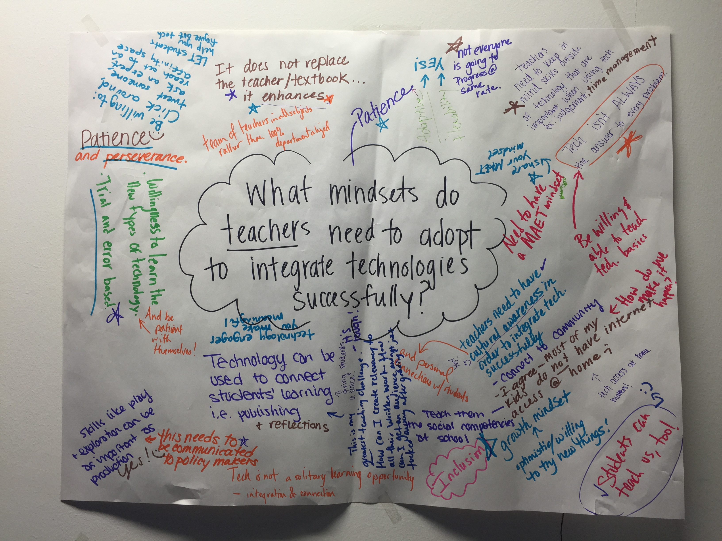
Finalizing Ideas--Chalk Talk
A silent activity
Use the provided markers to express your ideas.
Groups will rotate upon the signal.
Will end when you are back with your original sheet.
Use feedback to finalize the assigned work.
Wentworth, n.d.
Notes:
After chalk talk, assign each table one thing to work on…. Values, Vision, Mission, Literacy, Numeracy….Cultural goal if possible.

Slide 14
Next Steps
Given what we have discussed and learned today, what are some next steps we need to take?

Slide 15
Feedback
Using a post it note, create an exit slip assessing the collaborative inquiry process used during this time of today’s meeting and offering +/∆ feedback.

Slide 16
MNPS Collaborative Inquiry Toolkit
www.mnpscollaboration.org

Slide 17
References
Connell, G. (2013). 15 quick and creative ways to group and partner students. Scholastic website. Retrieved from http://www.scholastic.com/teachers/top-teaching/2013/11/15-quick-and-creative-ways-group-and-partner-students
Lipton, L. & Wellman, B. (2012). Got data? Now what? Bloomington, IN: Solution Tree.
Lipton, L. & Wellman, B. (2011). Groups at work: Strategies and structures for professional learning. Sherman, CT: MiraVia, LLC.
Sparks, D. (2007). Leading for results: Transforming teaching, learning, and relationships in schools. Thousand Oaks, CA: SAGE Publications.
Wentworth, M. (n.d.) Chalk talk. National School Reform Faculty website. Retrieved from http://www.nsrfharmony.org/system/files/protocols/chalk_talk_0.pdf

