Slide 1
Lakeview Elem Leadership Team Meeting

Slide 2
Today’s Purpose and Outcome
Our purpose is to foster a culture of collaboration to support student success.
Our outcome for today’s meeting is to use the collaborative inquiry process to analyze multiple sources of data to identify root causes.

Slide 3
Accomplishments
Reflecting upon 2017,what are some things our team accomplished?

Slide 4
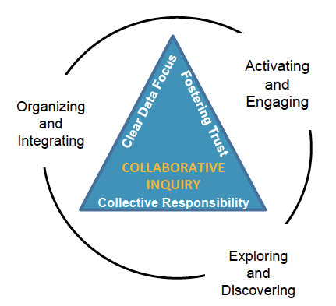

Slide 5
Exploring and Discovering
Notes:
Reiterate that when they look at the data, they are to only make observations, aka facts. Not inferences, or yeah, but….. or explanations.

Slide 6
Data Dive Observations
List Data Sources here…

Slide 8
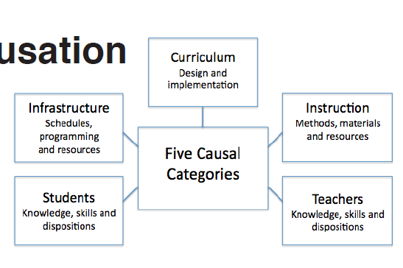
Causal Categories
--Lipton, L. & Wellman, B. (2012). Got data? Now what? Bloomington, IN: Solution Tree, Inc.
Notes:
Now that we have activated, engaged, explored, and discovered observations about the data, let’s begin organizing and integrating the data to generate theory. During this phase, we move from problem finding to problem solving. When looking at causation, theories fall into these five causal categories----
Let’s take few minutes to work in your small groups to complete the Theories of Causation worksheets.

Slide 9
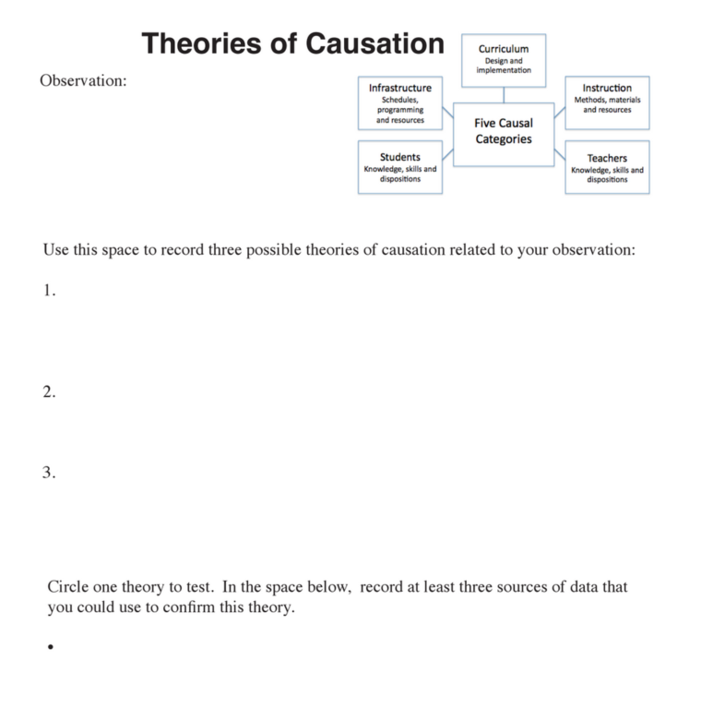
Individually generate a couple of theories of causation.
Students lack social emotional and self-regulatory skills.
Teachers’ instructional methods are not engaging to students.
Teachers lack the knowledge and skills to differentiate instruction in their classrooms.
Notes:
Individual, then small group and share out theories…..

Slide 10
Spend A Buck
You have 100 pennies to “spend” on the root causes we identified. You may ”spend” the pennies any way you want.
Please use post-its to “spend” your pennies as you leave the meeting.
Notes:
If time is running out…..You can compile the “votes” after the meeting to identify the top 1-2 areas.

Slide 11
Given what was discussed today, what might be some next steps?

Slide 12
Exit Ticket Reflection
What might be some actions you take as a result of our time together today?

Slide 13
Feedback--- How Was Today’s Meeting
Individually
Use a post-it note to provide feedback.

